Slide 1
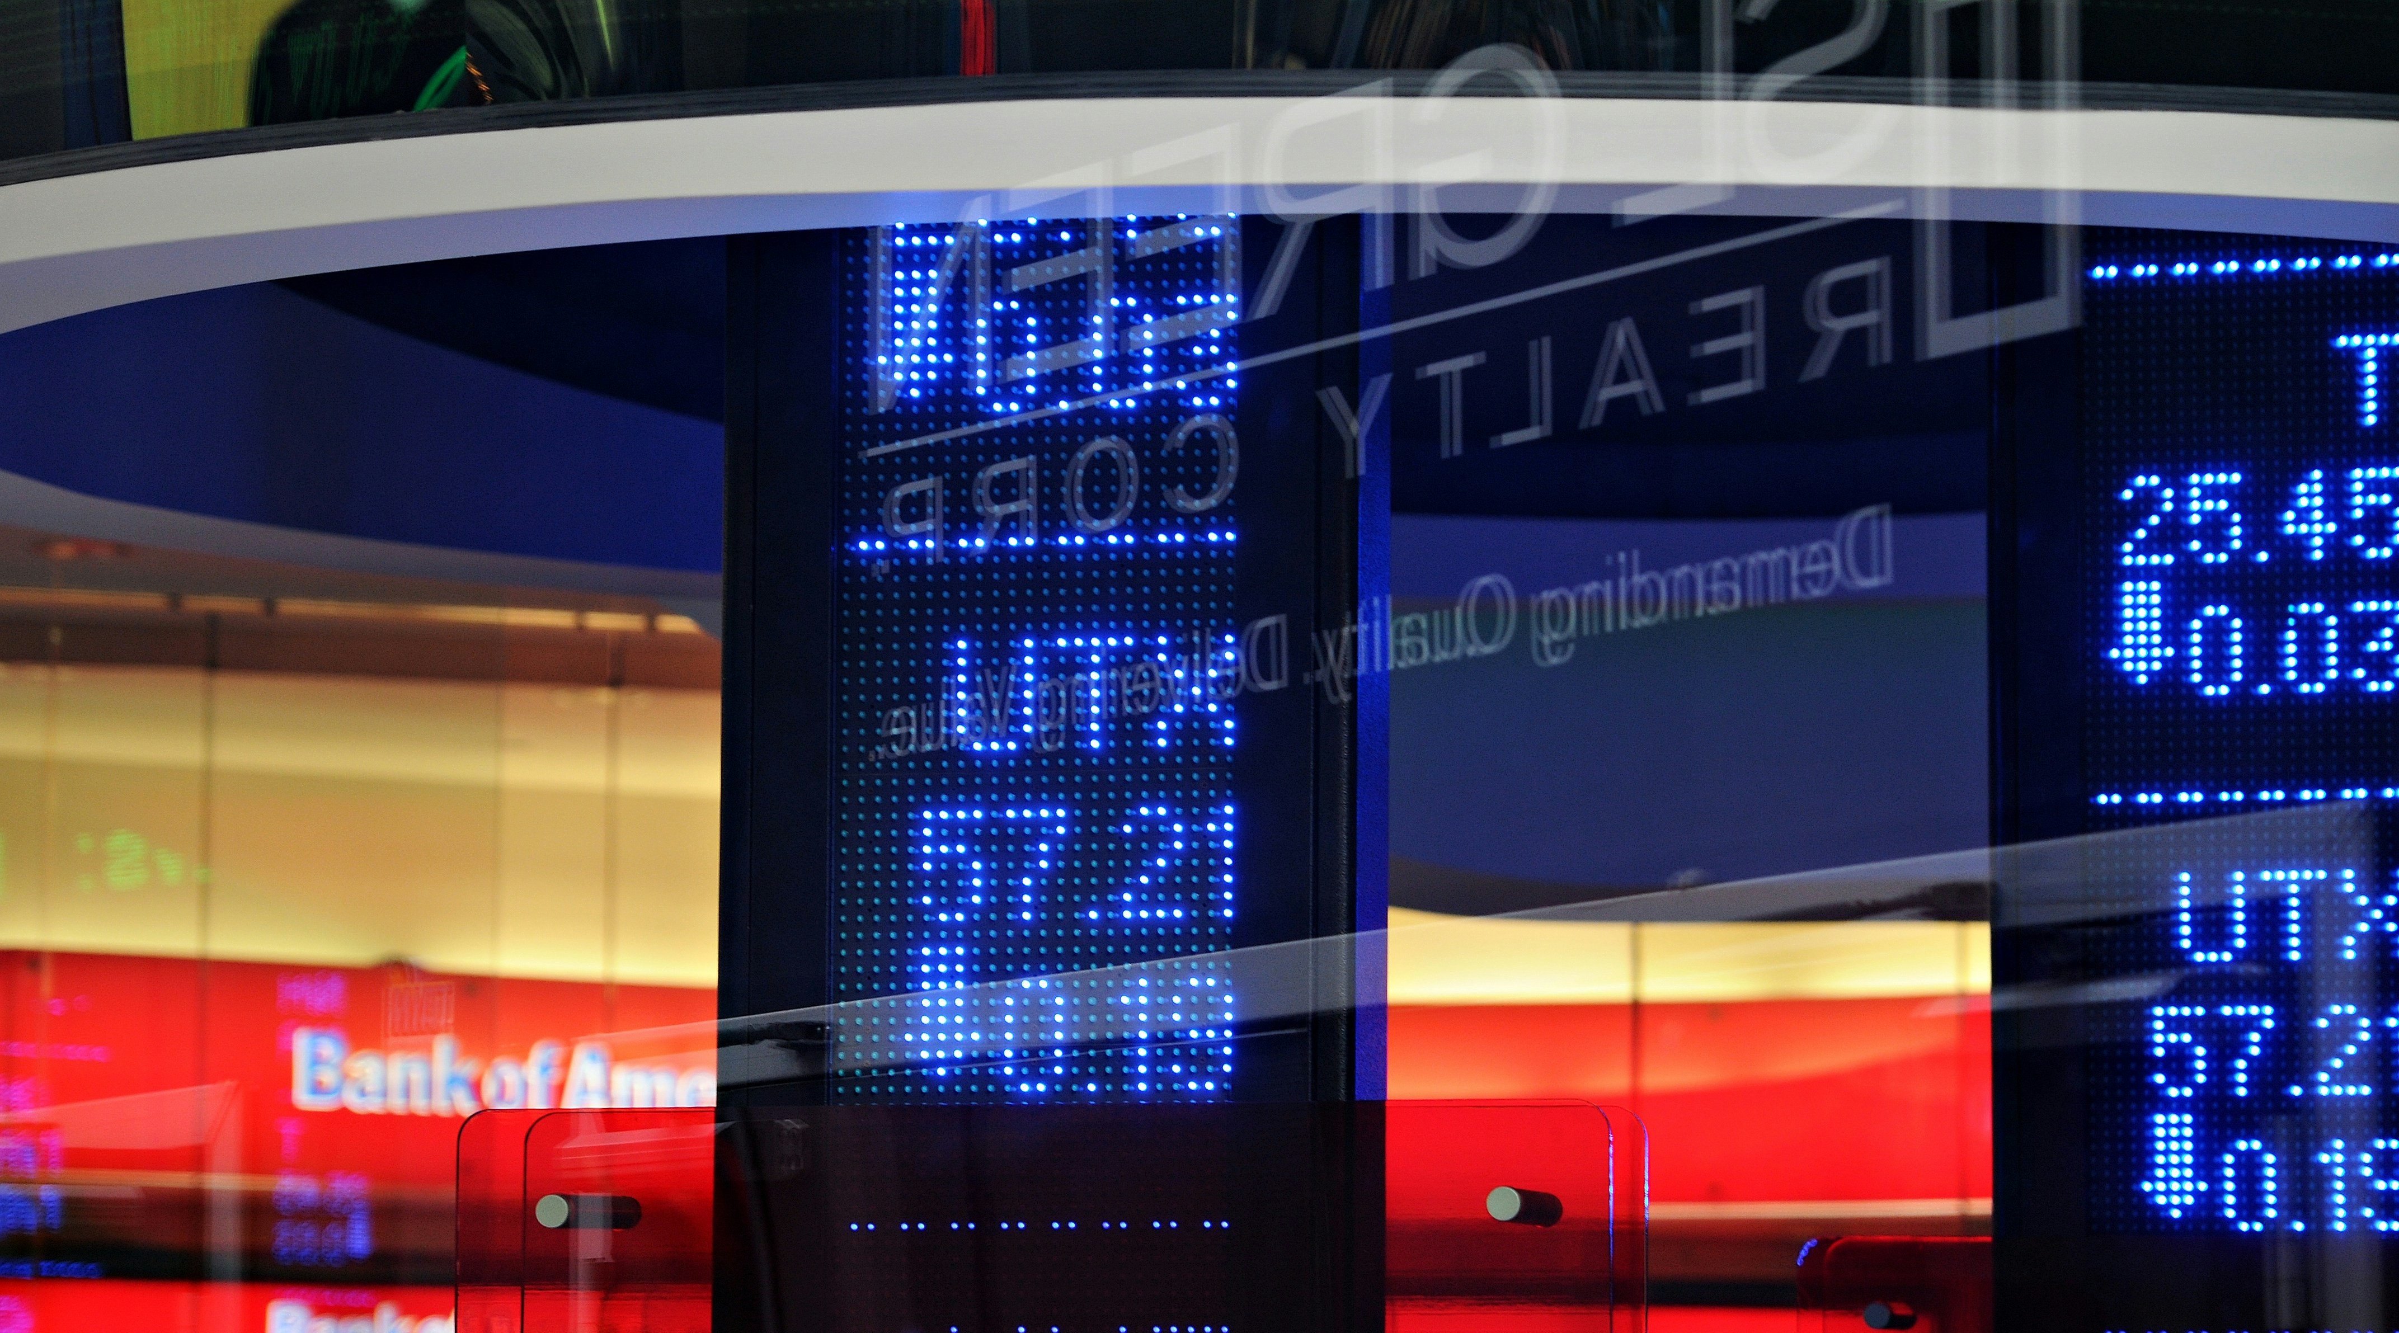
STOCK PRICE PREDICTION informed by social media communication
DESN 3002
Efsa AKTAY
Instructor: Kam-Ming Mark Tam
*The information is solely for research purposes and does not contain financial advice.

Slide 2
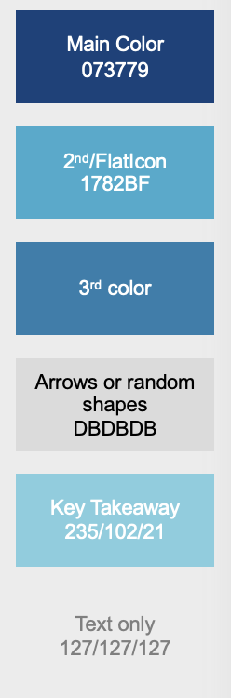
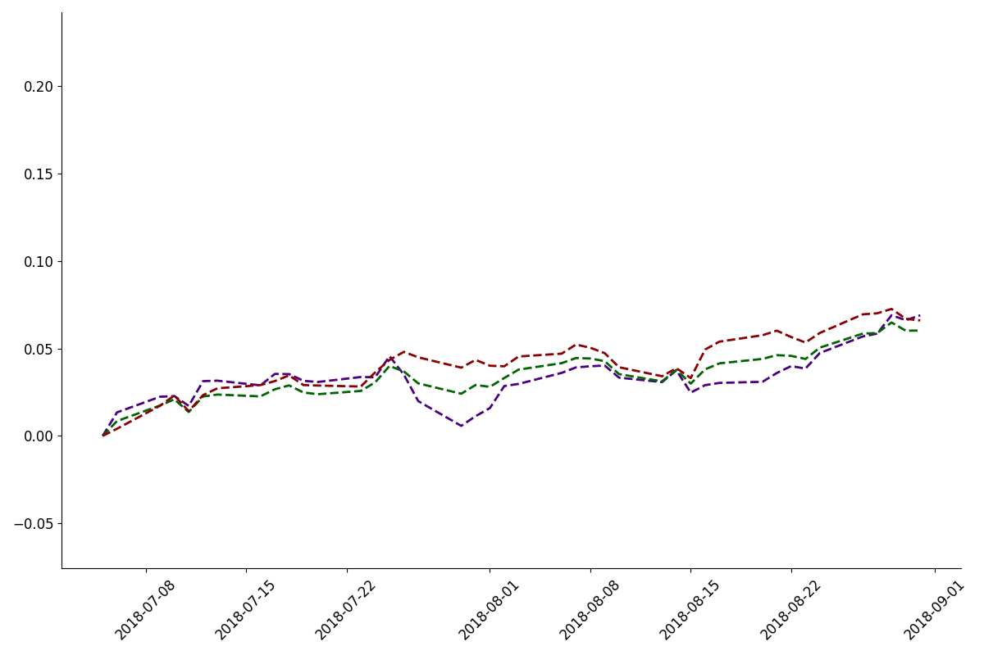
RELEVEANCE
Efsa Aktay
Normalised Price Change
Date
Yahoo Finance, Matplotlib

Slide 3
RELEVEANCE
Efsa Aktay
Normalised Price Change
Date
Yahoo Finance, Matplotlib

Slide 4
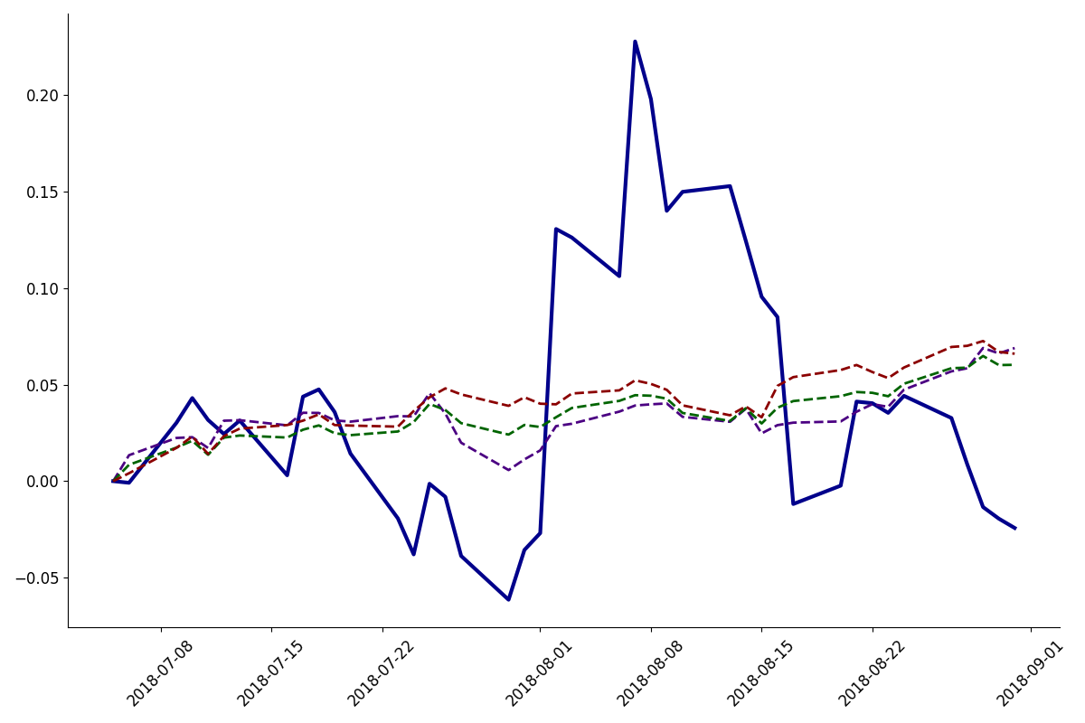
RELEVEANCE
Efsa Aktay
Normalised Price Change
Date
Yahoo Finance, Matplotlib

Slide 5
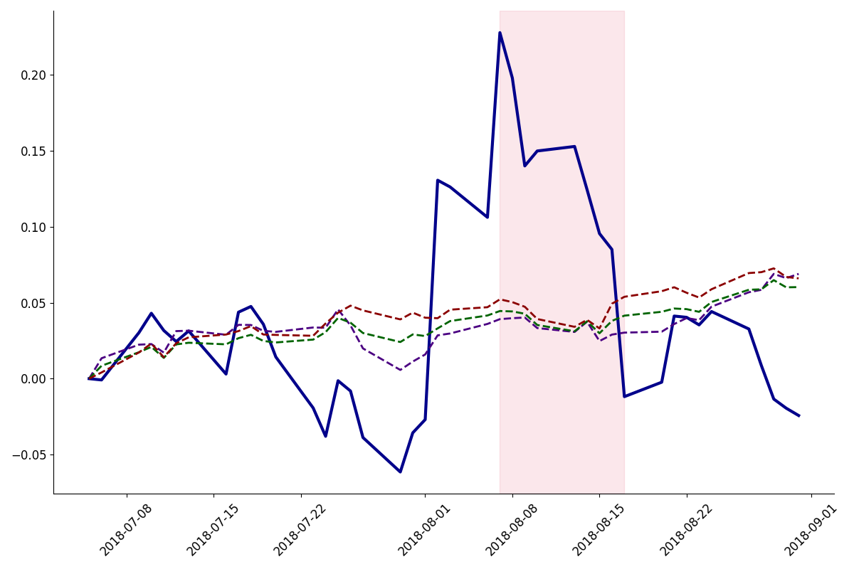
RELEVEANCE
Efsa Aktay
Normalised Price Change
Date
Yahoo Finance, Matplotlib

Slide 6

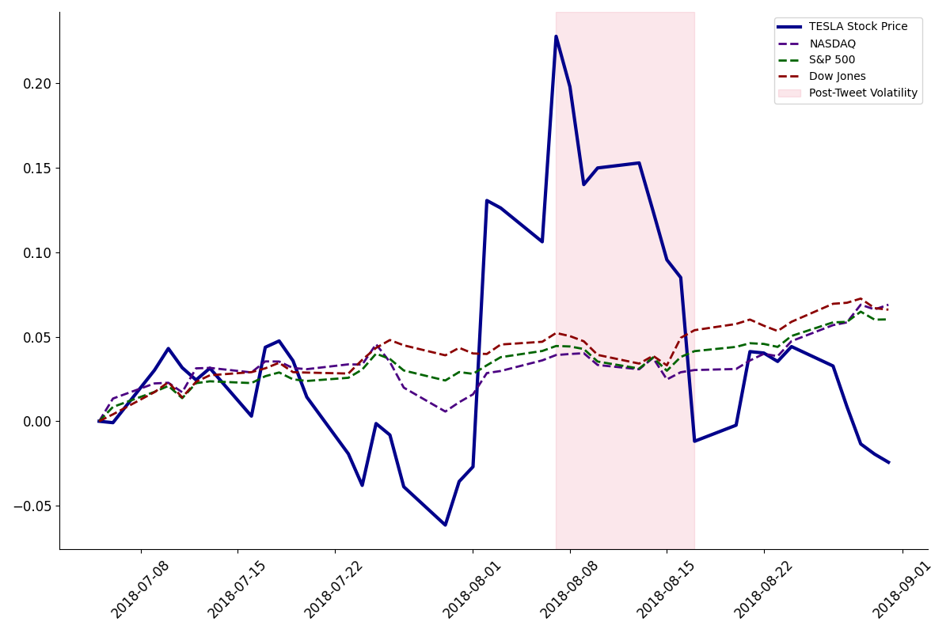

RELEVEANCE
Efsa Aktay
…taking Tesla private at $420. Funding secured.
Normalised Price Change
Date
Yahoo Finance, Matplotlib

Slide 7

CAN A REDDIT PAGE REVIVE A COLLAPSING COMPANY?
#RoaringKitty
CNN News

Slide 8

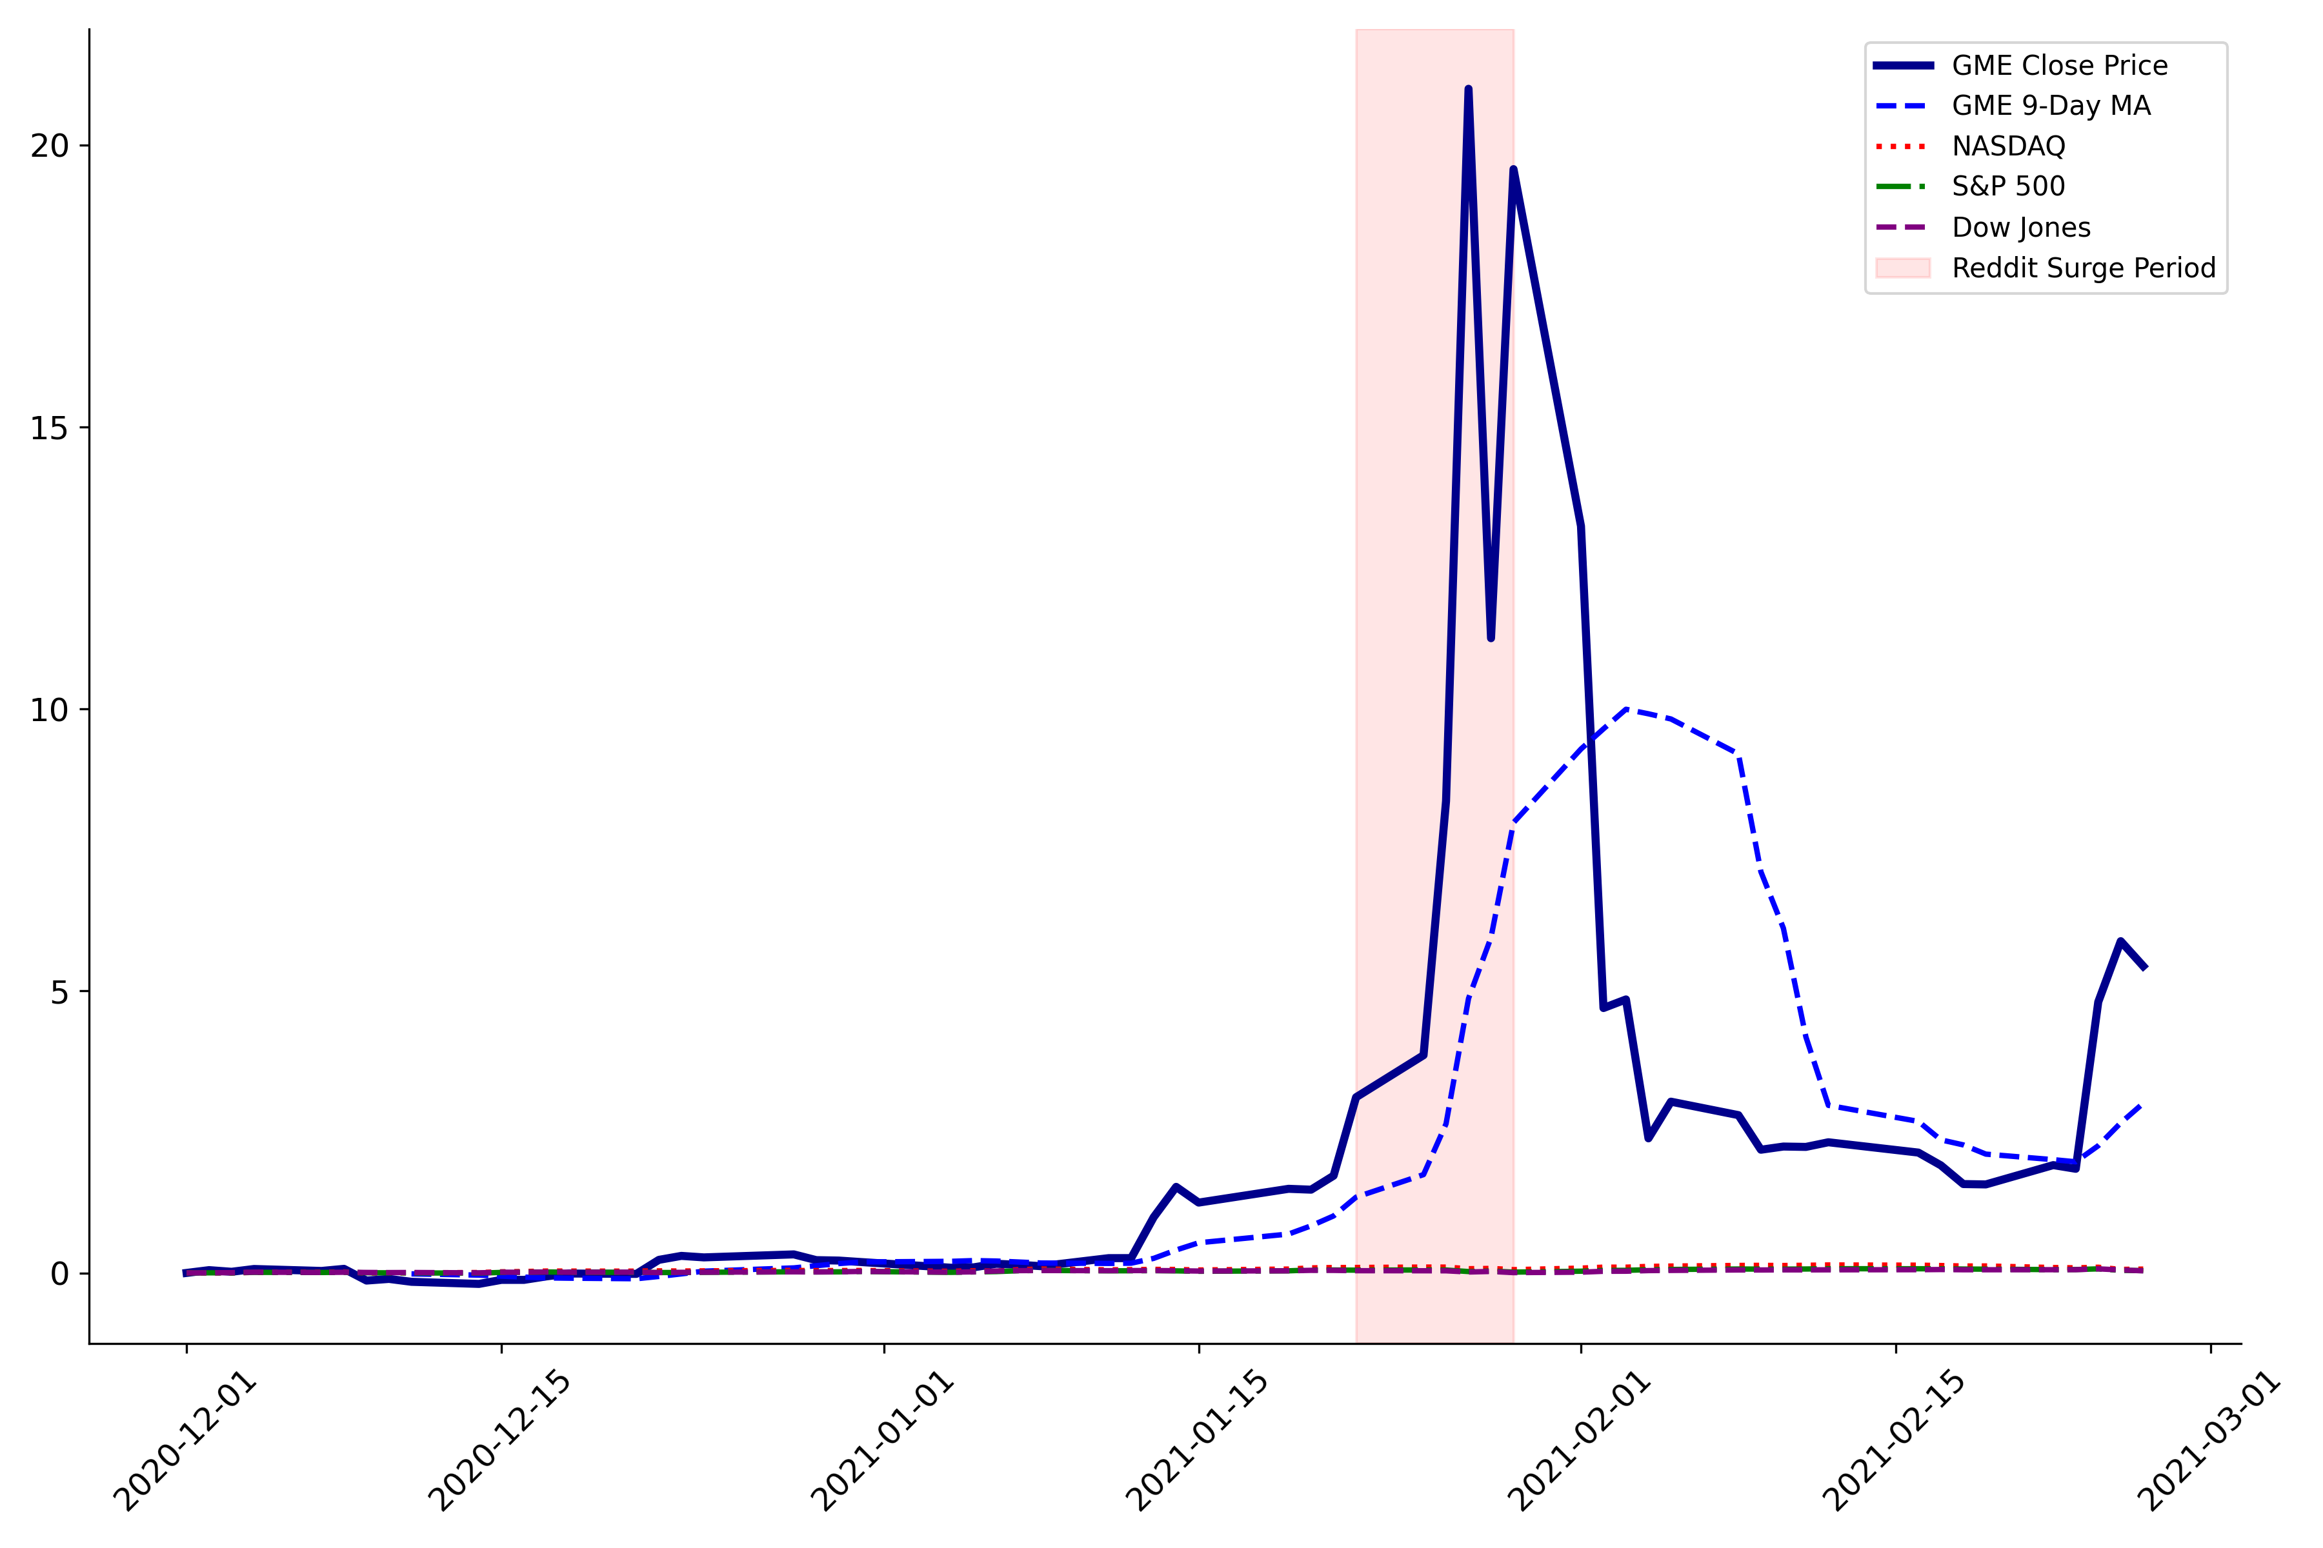
RELEVEANCE
Efsa Aktay
GameStop Price Movement (Dec 2020 - Feb 2021)
Normalised Price Change
…….Things got so heated on the subreddit, that news outlets such as Bloomberg began to report on it…….
Yahoo Finance, Matplotlib , X( formerly known Twitter)

Slide 9
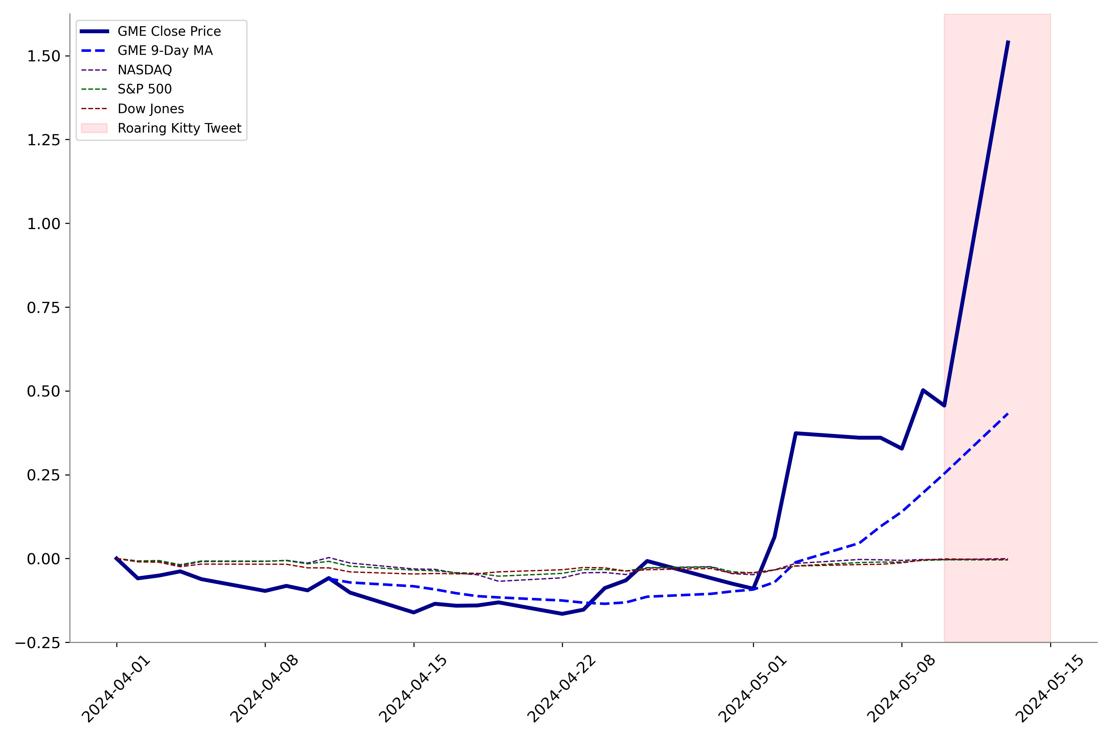


RELEVEANCE
Efsa Aktay
GameStop Price Movement (May 2024)
Normalised Price Change
After a regular r/wallstreetbets user made a return to twitter with a meme, the stock soared up again.
Yahoo Finance, Matplotlib , X( formerly known Twitter)

Slide 10
MOTIVATION
What company CEOs say could have a huge impact on the company
Unpredictability: CEO’s statements are an unpredictable input which makes analysis interesting.
Manipulation: CEO statements can manipulate stock prices, affecting market trust.
Impact on Livelihoods: Director communications can directly impact finances and jobs due to public and employee stock ownership.
Variable Significance: The effect of their statements ranges from trivial to substantial, depending on the context.

Slide 11
OBJECTIVE
Stock price prediction informed by CEO social media communication
Goal:
Identify predictive insights from social media trends
Study the modelling errors, loss, robustness
Modelling:
Utilise Deep Learning and LLMs which are the emerging technology to produce text data insights
Data Generation:
Using AI to study idealised dummy data informed by the case study
Secondary Goal:
Learn quantitative financial modelling
Data science and data handling and processing

Slide 12
EMERGING TECHNOLOGY USE
LLMS + AI
This work uses it to process + embed text
To generate synthetic data for studies

Slide 13
TABLE OF CONTENTS
Efsa Aktay
Introduction
Overview of Existing Research
Relevant Theory
Methodology
Research Design
Data Collection Methods
Analytical Techniques
Results & Discussion
Data Analysis
Key Findings
Conclusion
Summary of Findings
Suggestions for Further Research

Slide 14
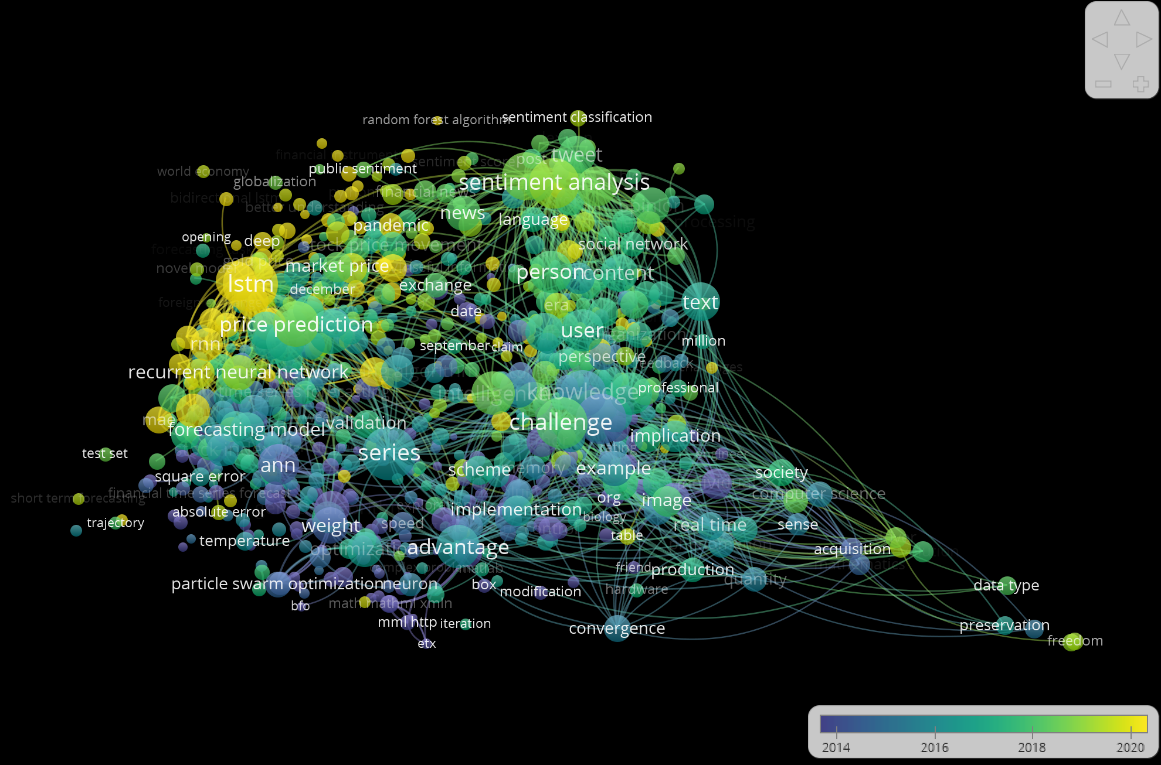
LITERATURE REVIEW – Cluster Algorithm
Efsa Aktay
VOS viewer Software

Slide 15
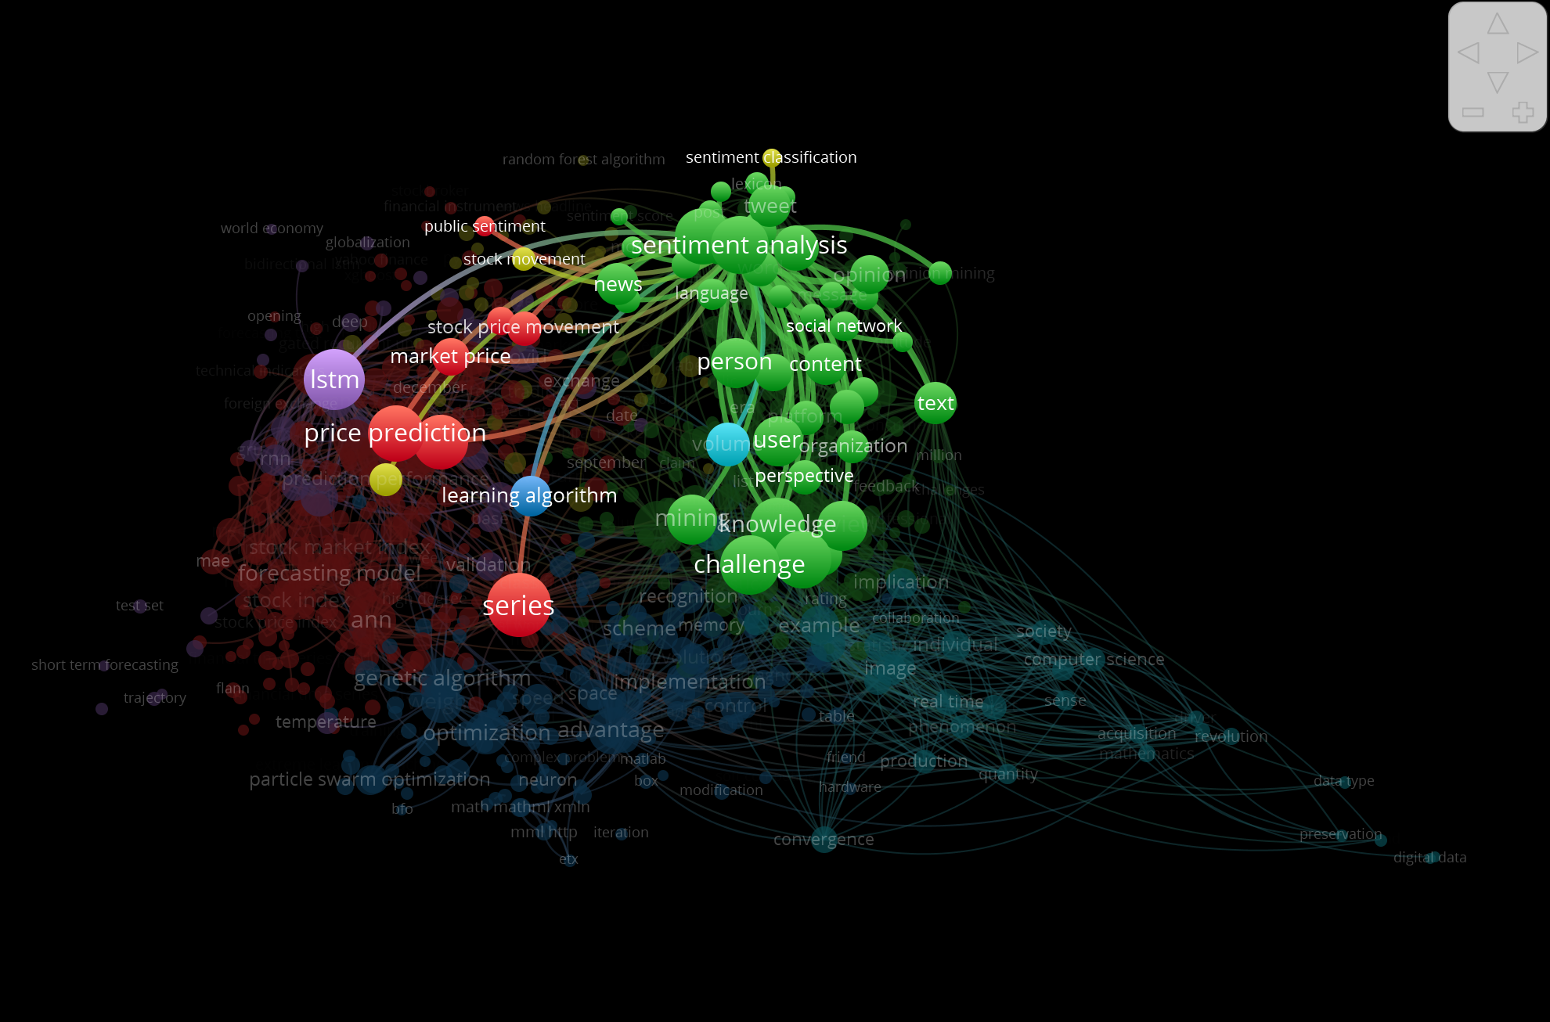
LITERATURE REVIEW – Cluster Algorithm
Efsa Aktay
VOS viewer Software

Slide 16
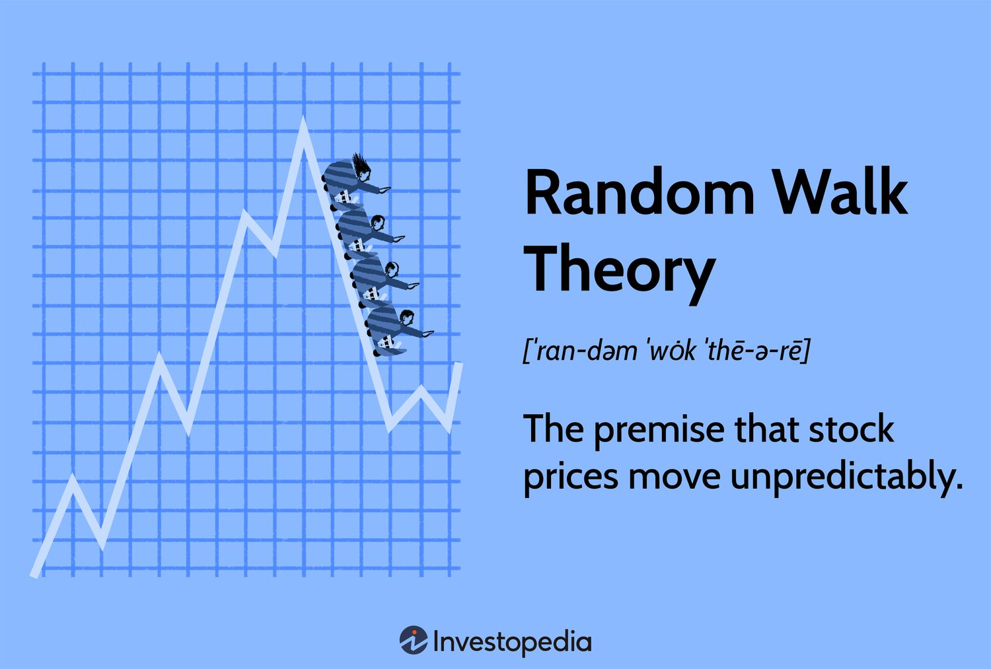
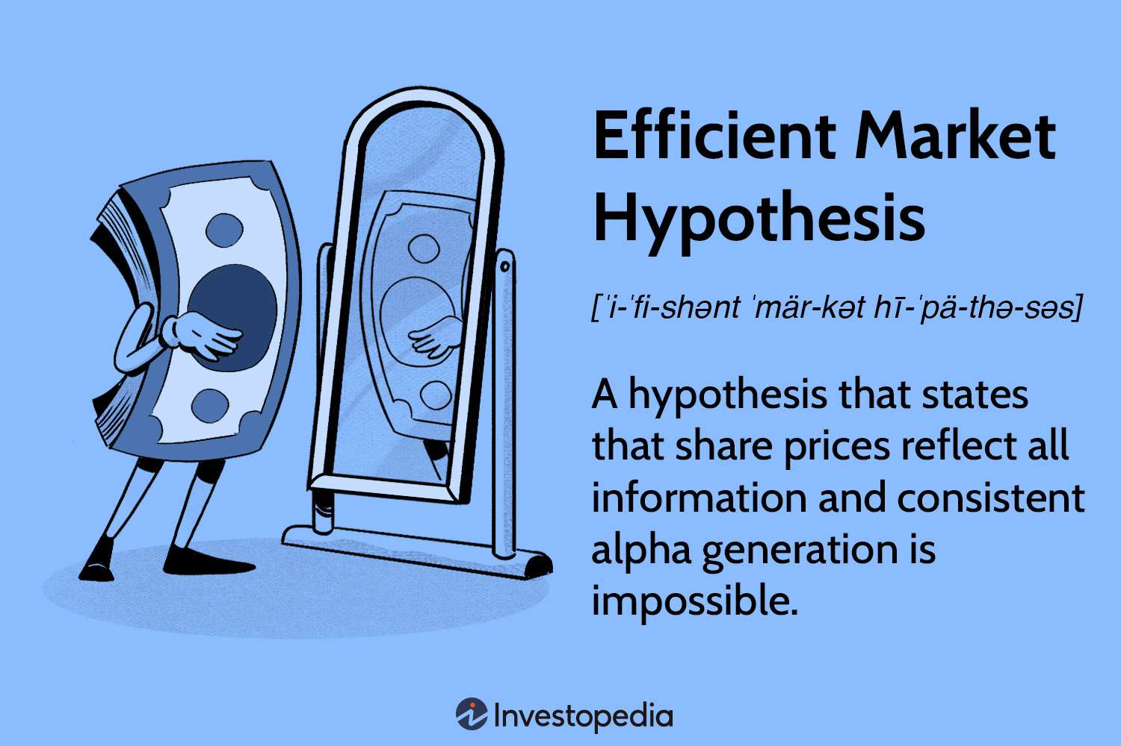
STOCK MARKET THEORIES
Efsa Aktay
Random Walk Principle
Efficient Market Hypothesis
Study considers both the unpredictability of the stock market as well as the impact of information on the price changes.
Investopedia Visuals

Slide 17

METHODOLOGY

Slide 18
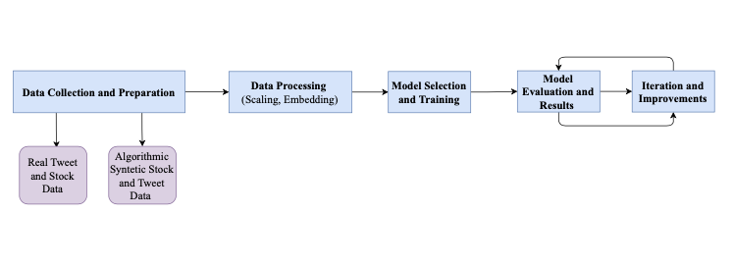
OVERALL WORKFLOW
Efsa Aktay
Draw.io

Slide 19
OVERALL WORKFLOW
Efsa Aktay
Why generate synthetic data?
Validate the Model
Systematically mimic the inputs from actual case
Have a baseline
Draw.io

Slide 20

EXPERIMENTATION SUMMARY – SYNTHETIC DATA
 | STOCK (Stock 1, Stock 2, Stock 3) | INDEX (Index 1, Index 2, Index 3) | TWEET (CEO1, CEO 2, CEO 3)
TEST #1
TEST #2

Slide 21
EXPERIMENTATION SUMMARY – REAL DATA
 | STOCK (APPLE, TESLA) | INDEX (NASDAQ, DOWJ, S&P500) | TWEET (ELON MUSK ,TIM COOK)
TEST #1
TEST #2

Slide 22

DATA & MODELLING

Slide 23
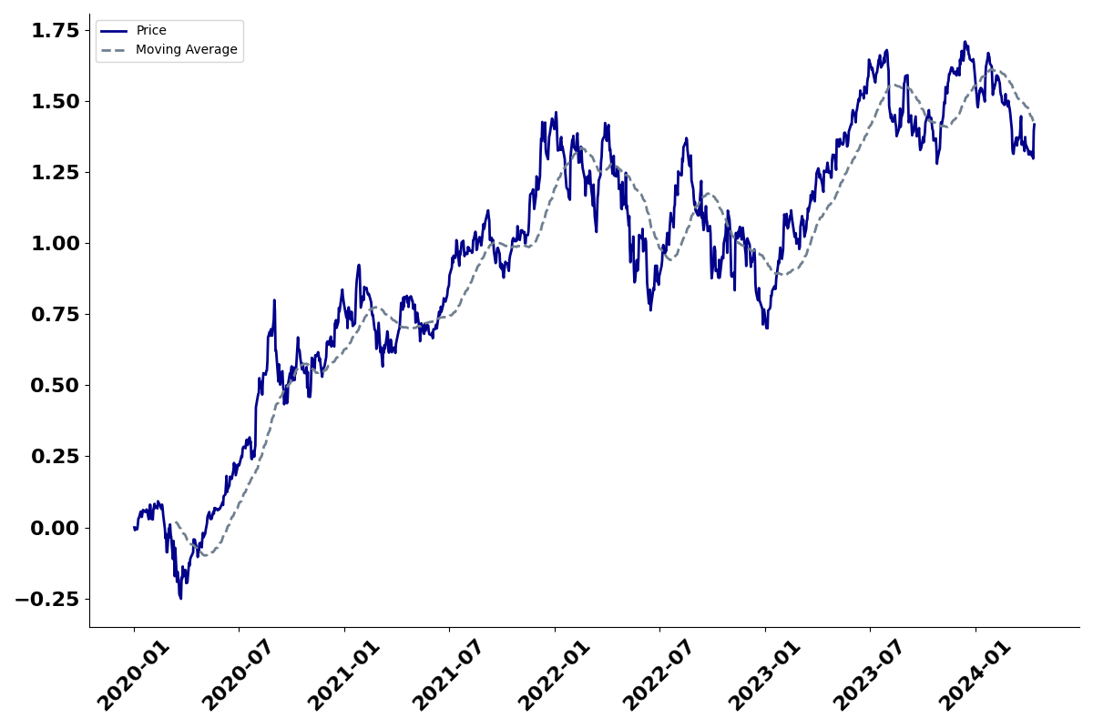
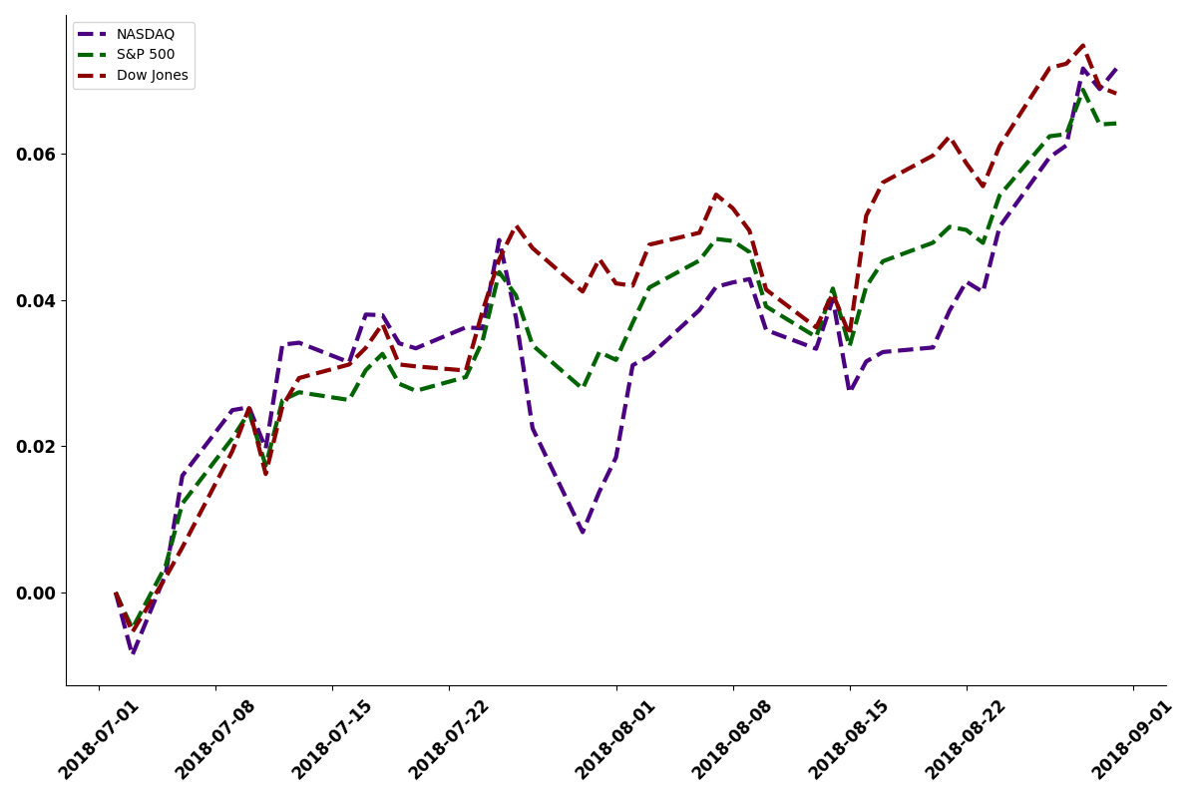



STOCKS
0.23 | 0.35 | 0.47 | 0.98 | 0.56 | 0.78 | 0.23
STOCK 1
0.23 | 0.35 | 0.47 | 0.98 | 0.56 | 0.78 | 0.23
STOCK 2
0.23 | 0.35 | 0.47 | 0.98 | 0.56 | 0.78 | 0.23
STOCK 3
DATASET
0.23 | 0.78 | 0.47 | 0.98 | 0.56 | 0.78 | 0.23
INDEX 1
INDEXES
0.98 | 0.76 | 0.65 | 0.72 | 0.688 | 0.76 | 0.59
INDEX 2
0.23 | 0.38 | 0.47 | 0.98 | 0.56 | 0.78 | 0.23
INDEX 3
Tweet |  | Tweet | Tweet | Tweet |  | Tweet | Tweet | Tweet
CEO 1
We are having supply chain issues.
Stay tuned for the announcement
We launched a new product!
Stay tuned for the announcemnt
Tweet |  |  | Tweet | Tweet |  | Tweet
CEO 2
 |  | Tweet | Tweet |  |  | Tweet | Tweet
CEO 3

Slide 24

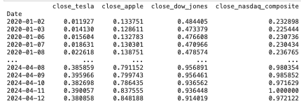

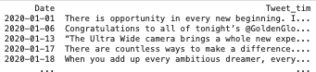
STOCKS
STOCKS & INDEXES
DATASET
INDEXES
TWEETS
We launched a new product!
We are having supply chain issues.
Stay tuned for the announcement

Slide 25
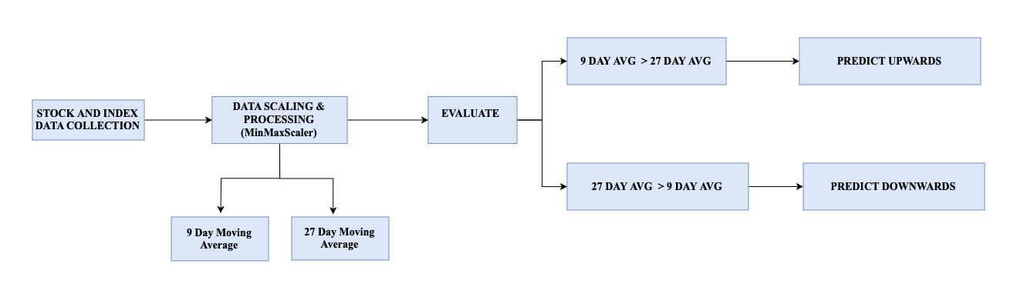
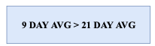

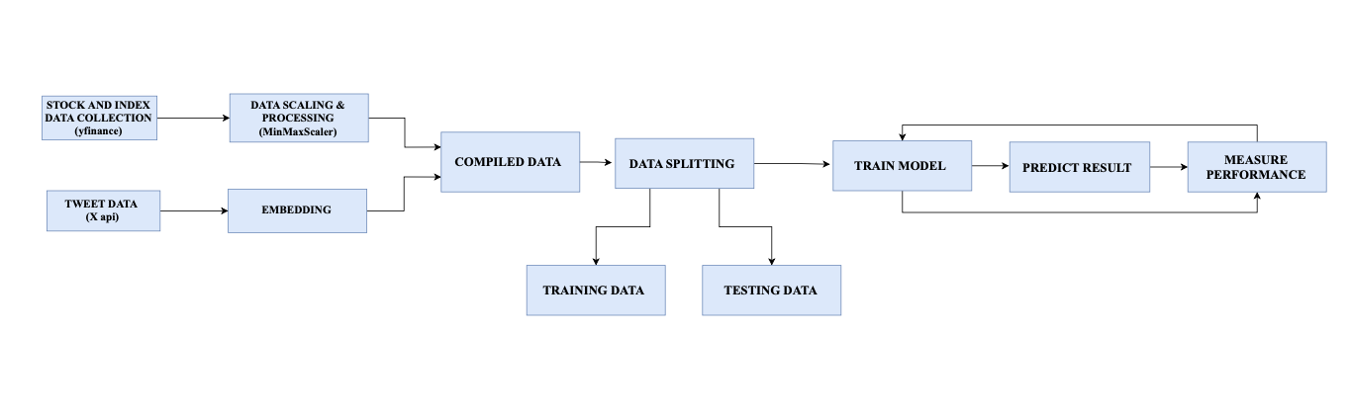
MACHINE LEARNING WORKFLOW & STATISTICAL ANALYSIS
Efsa Aktay
STATISTICAL ANALYSIS
MACHINE LEARNING ANALYSIS

Slide 26
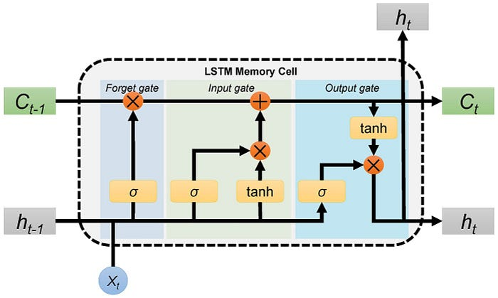
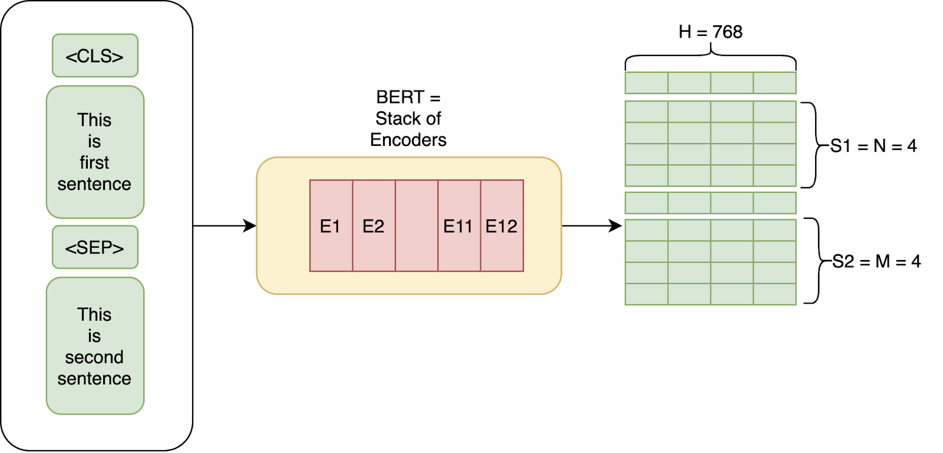
SELECTION OF MODEL LSTM and BERT EMBEDDING
LSTM ARCHITECTURE
BERT EMBEDDING
Appropriate for Timeseries Analysis and NLP
Appropriate processing the text data

Slide 27
BERT EMBEDDING
”EMBEDDING”
TWEETS/TEXT
VECTORS
…economic downturns…. #Determination
...supply chain disruptions….. #Resilience.
…commitment to excellence. …. #Leading Edge
…cutting-edge solution…. #InnovationLeadership
+1.2
+0.24
+8.3
-0.5
…
+3.2
+1.2
+0.24
+8.3
-0.5
…
+3.2
+1.2
+0.24
+8.3
-0.5
…
+3.2
+1.2
+0.24
+8.3
-0.5
…
+3.2

Slide 28
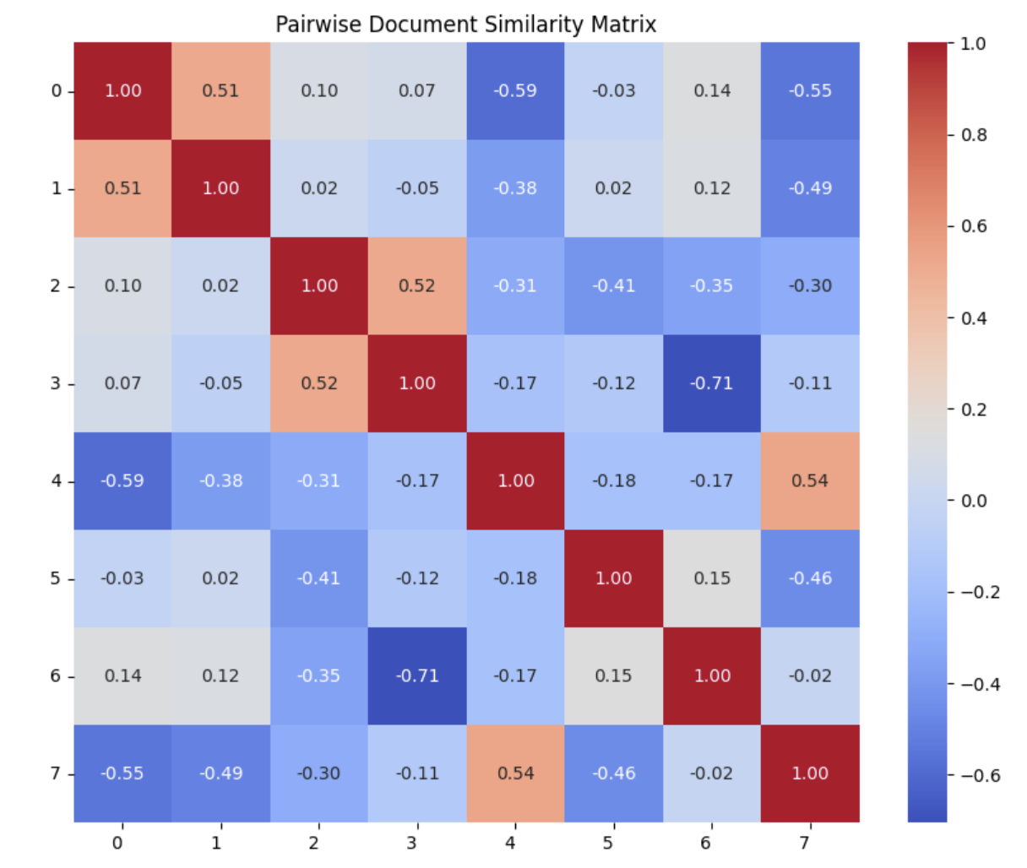
GPT Scenario Embedding Diagram
”EMBEDDING”
TWEETS/TEXT
VECTORS
…economic downturns…. #Determination
…..competitive pressures…..#Unity
...supply chain disruptions….. #Resilience.
….tightening regulations… #StayStrong
…next-gen technology… #MarketLeader
… earnings call …. #Announcement
…commitment to excellence. …. #Leading Edge
…cutting-edge solution…. #InnovationLeadership

Slide 29
MODEL MECHANICS
DATASET
UNSEEN DATA
train
test
VALIDATION

Slide 30
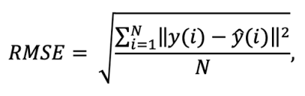
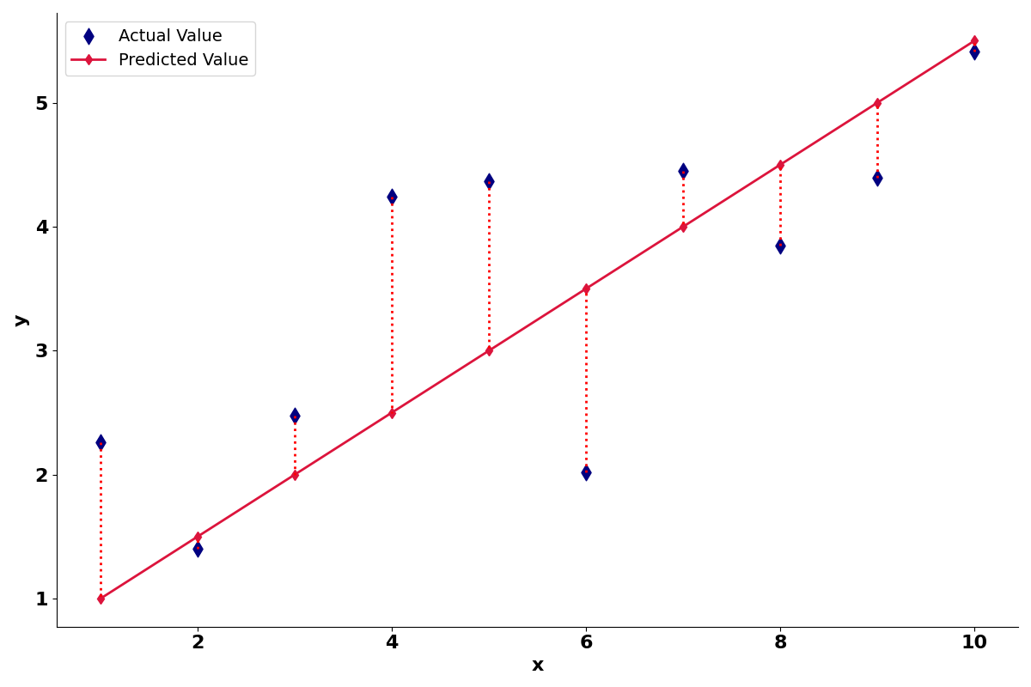
MACHINE LEARNING LOSS
FORMULA
ACTUAL VALUE
ERROR
PREDICTED VALUE

Slide 31
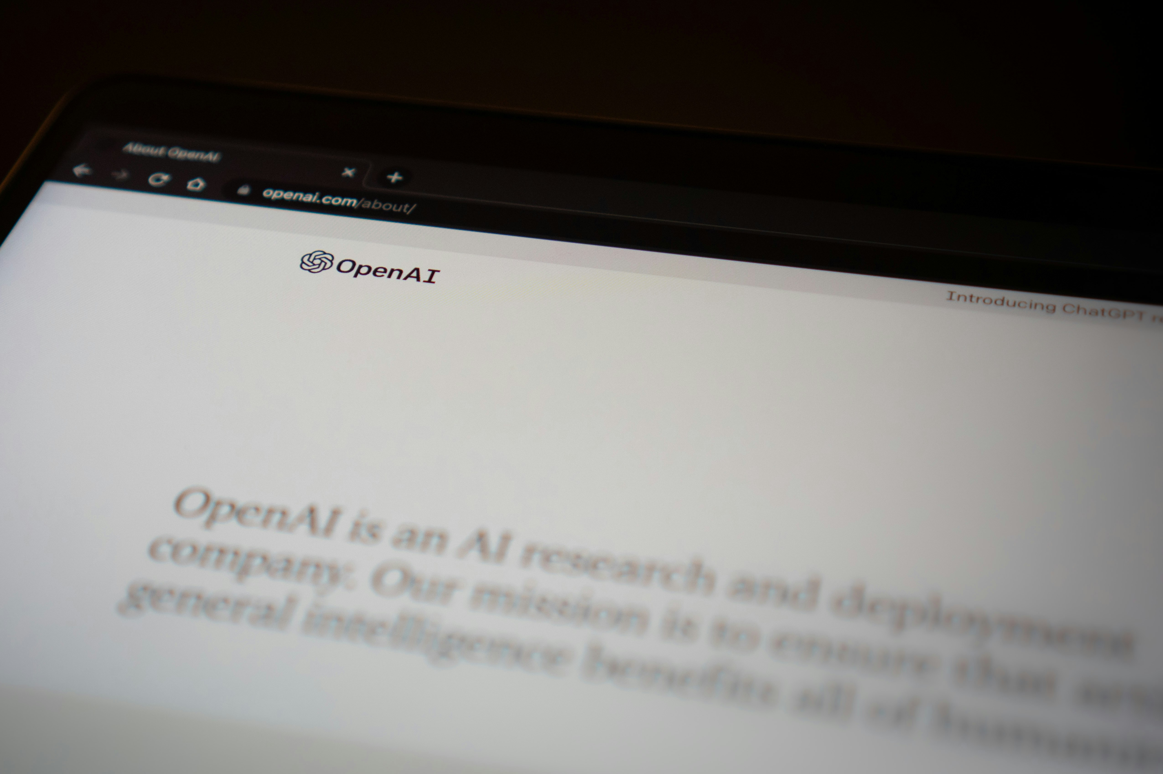
Chat-GPT 4 Generated
Scenarios

Slide 32
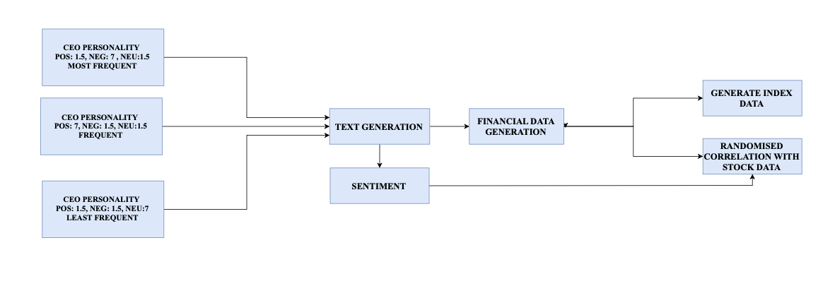

SYNTHETIC DATA GENERATION

Slide 33
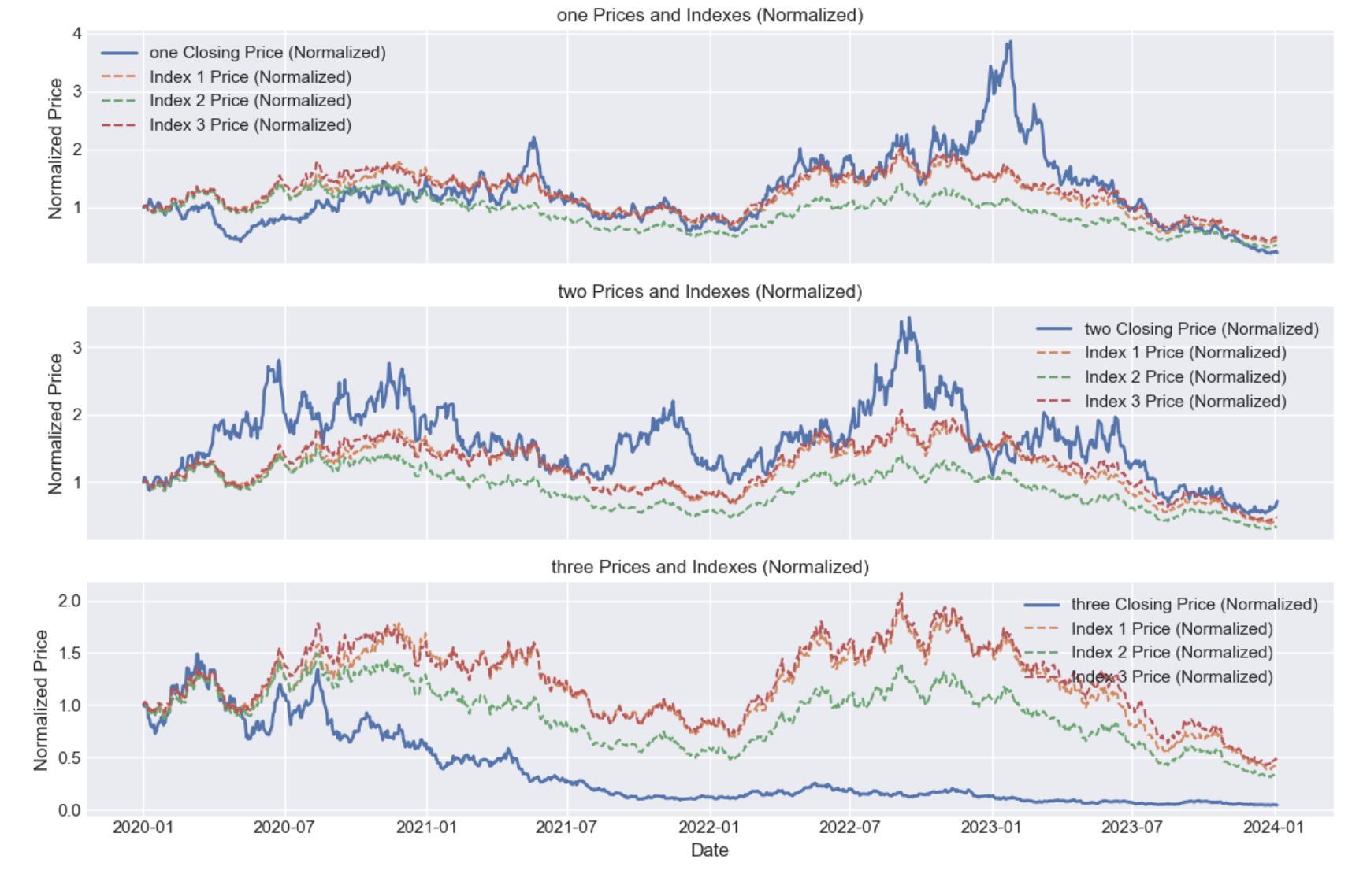
SYNTHETIC STOCK DATA
STOCK 1 & INDEXES
STOCK 2 & INDEXES
STOCK 3 & INDEXES

Slide 34
SYNTHETIC TWEET DATA
negative | While facing competitive pressures, we're taking steps to pivot our focus. It's a critical time. #CriticalTimes
positive | Breaking news: Our next-gen technology has revolutionized the industry by setting new standards. #MarketLeader
neutral | Tune in for our partnership announcement this week. Exciting updates to share! #CorporateUpdate
The topics of each tweet consists of products, achievements, challenges, strategies, updates, adjectives, outcomes, events

Slide 35
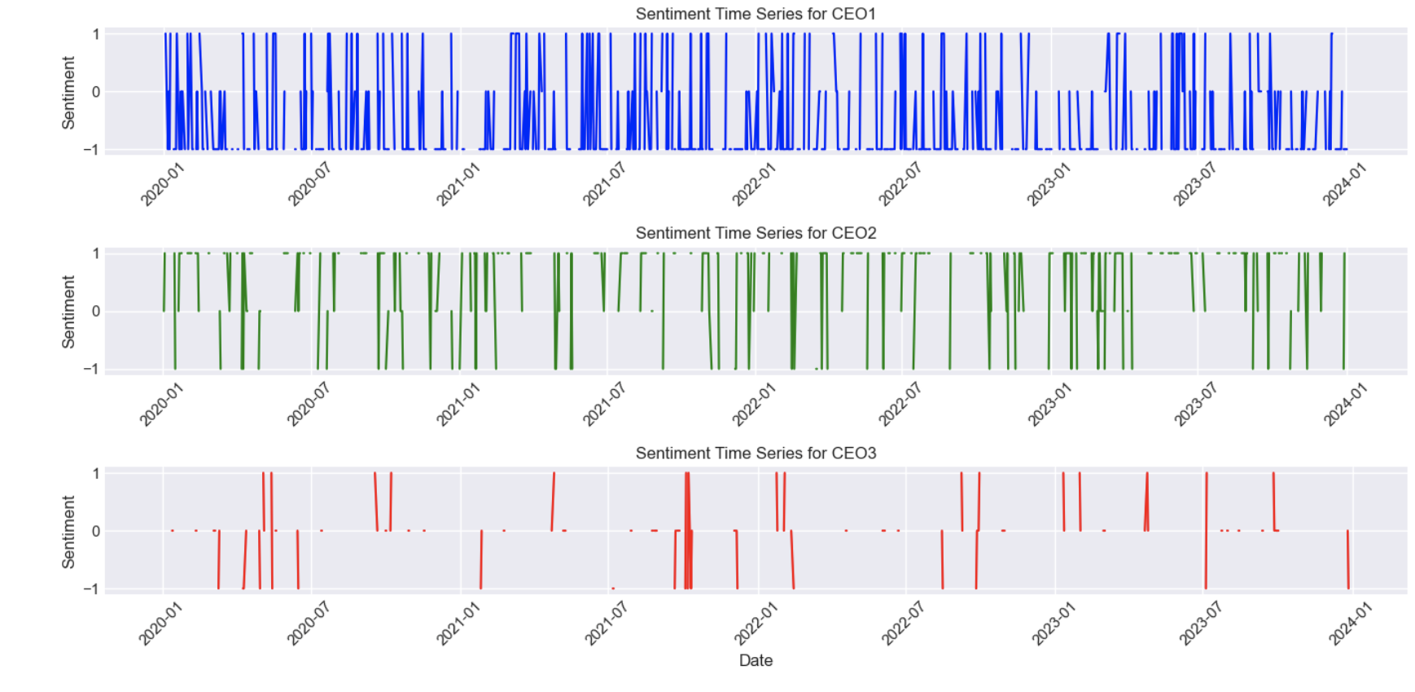
SENTIMENT AND FREQUENCY OF SYNTHETIC TWEET DATA

Slide 36

SYNTHETIC DATA RESULTS

Slide 37
LOSS CHART SYNTHETIC DATA

Slide 38
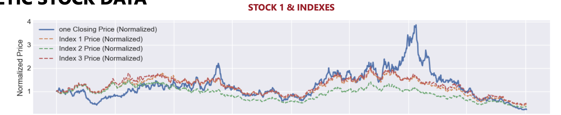
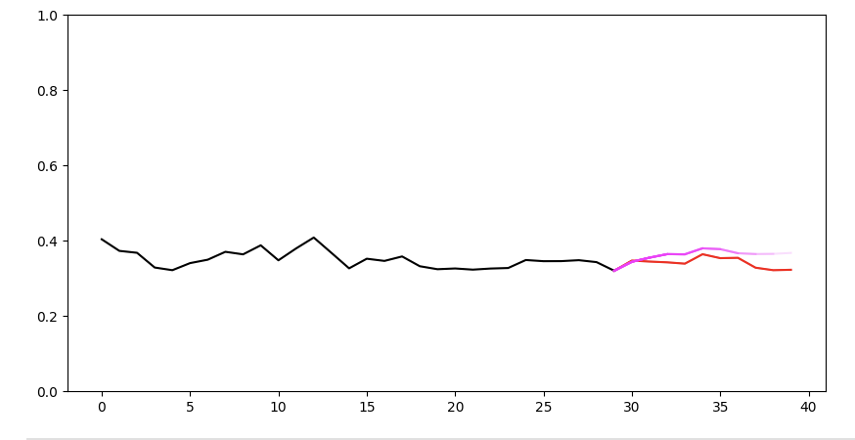
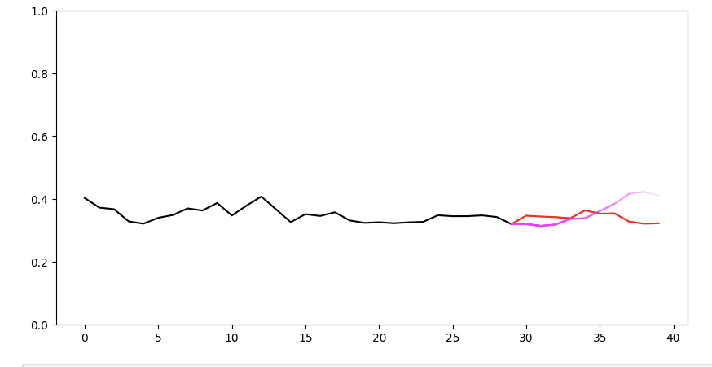
LOOKING AT CERTAIN TIMEFRAMES
STOCK 1 & INDEXES
WITH TEXT
WITHOUT TEXT

Slide 39
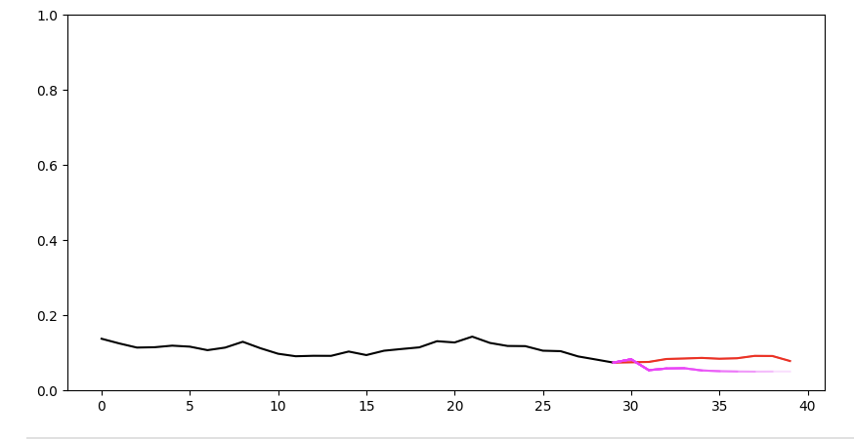
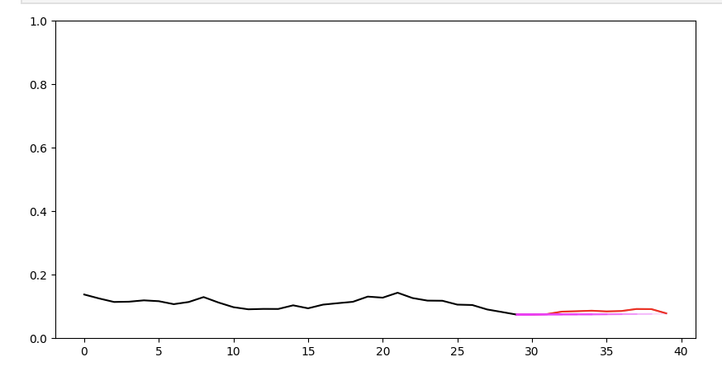
LOOKING AT CERTAIN TIMEFRAMES
STOCK 2 & INDEXES
WITH TEXT
WITHOUT TEXT

Slide 40
REAL CASE RESULTS

Slide 41
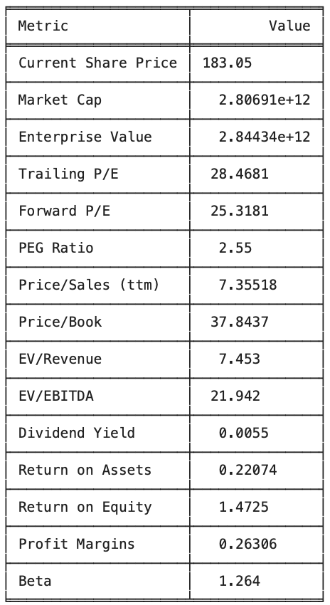
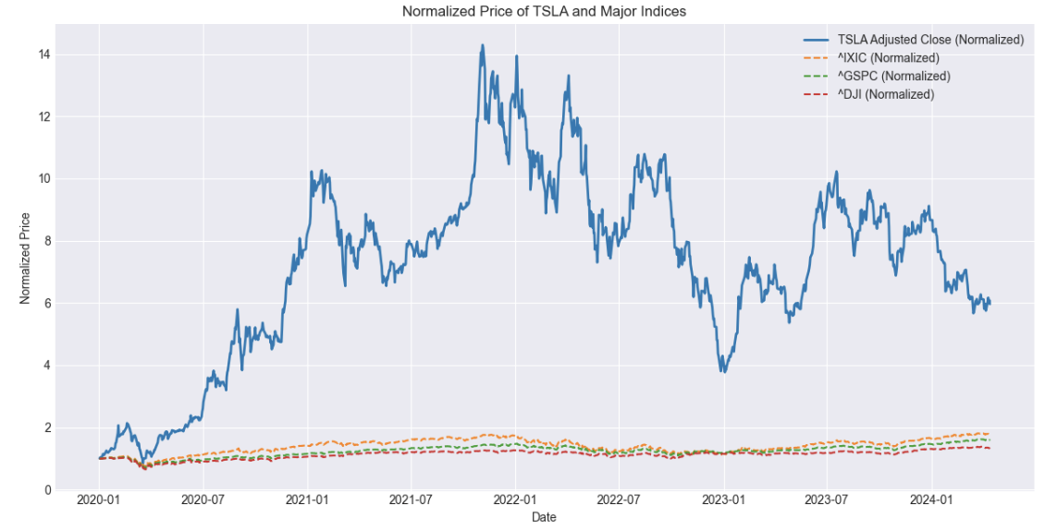
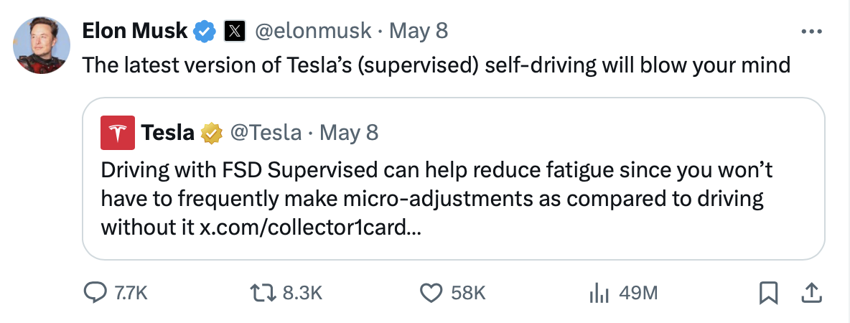
TESLA (TSL)
Statista (2024)

Slide 42
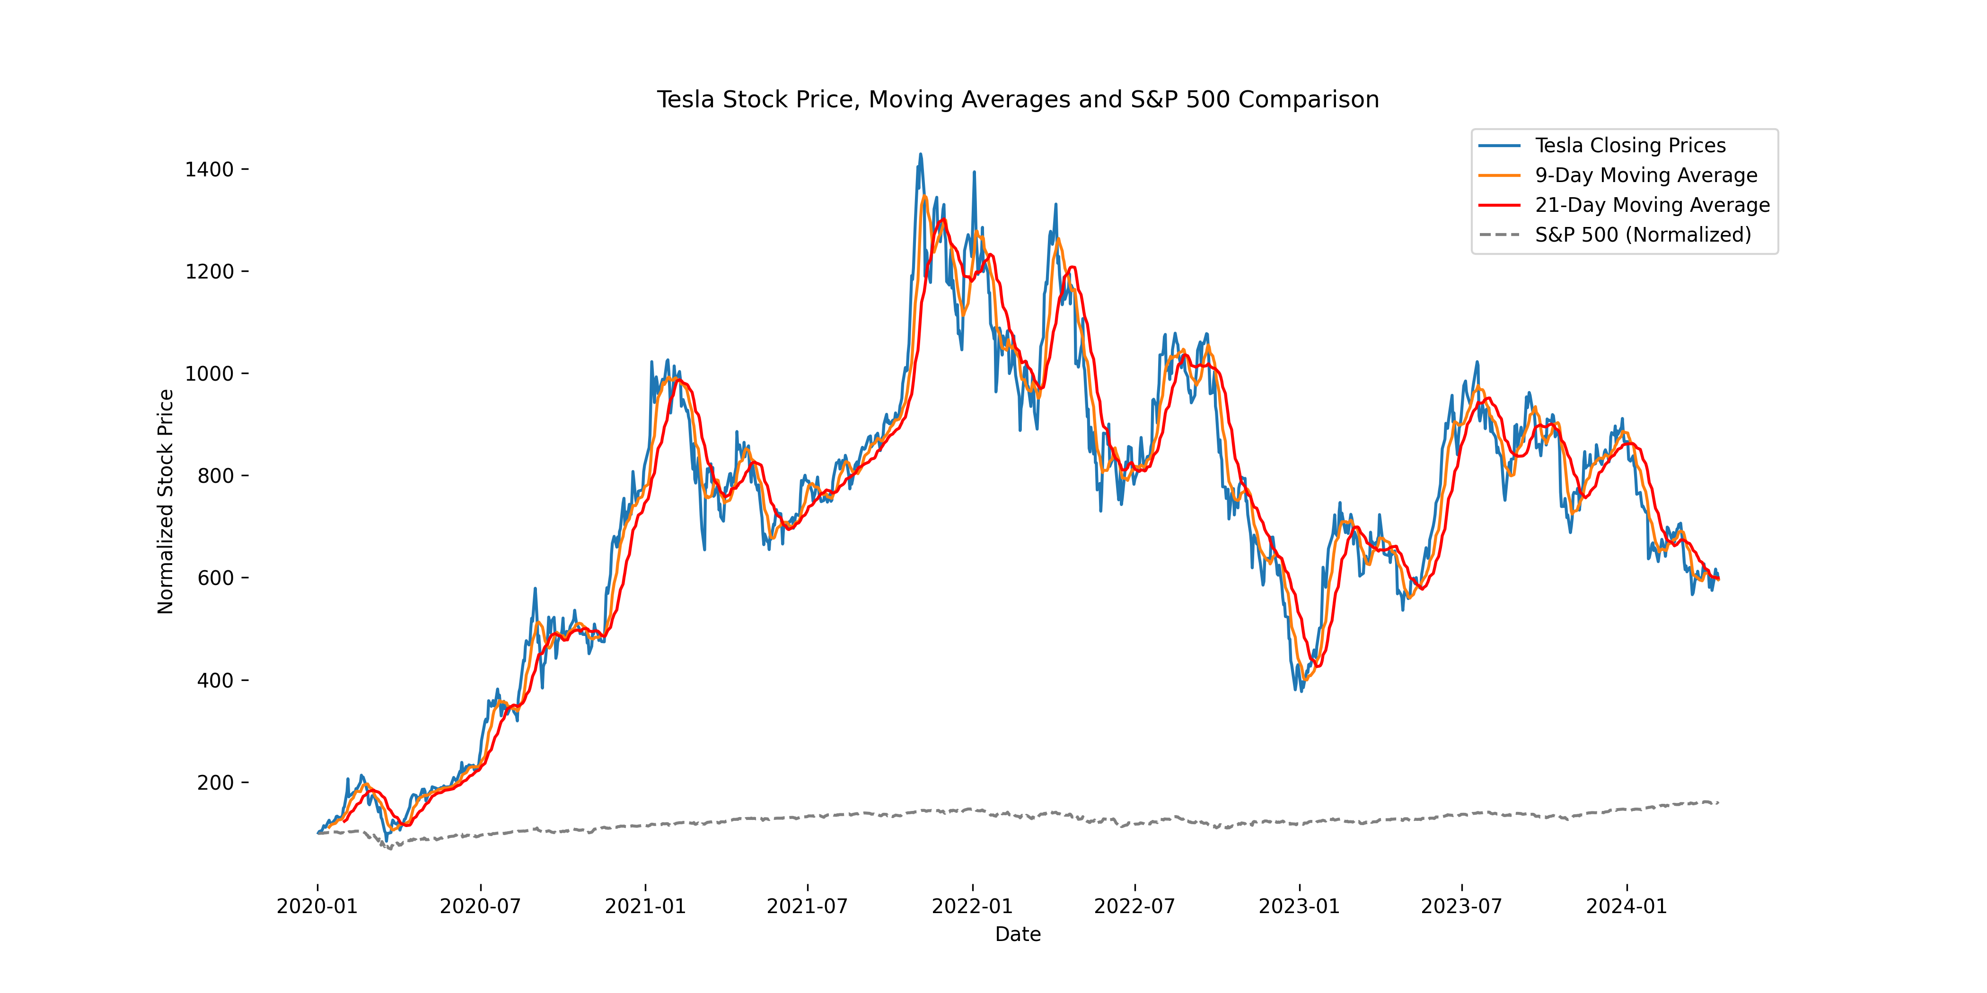
TESLA

Slide 43
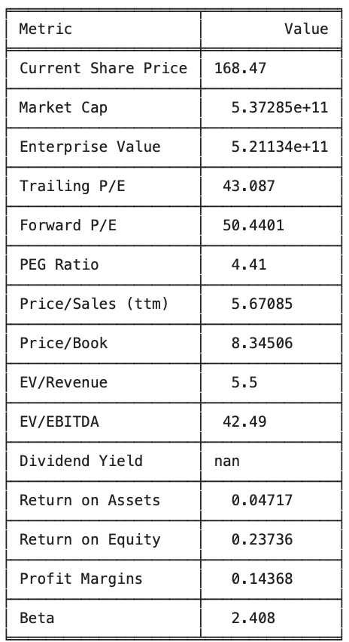
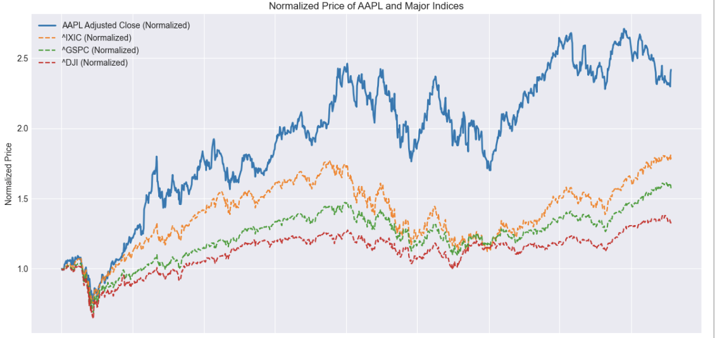
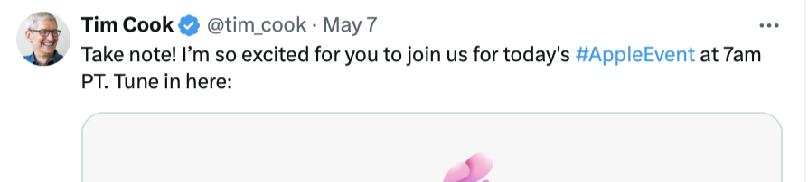
APPLE (AAPL)
Statista (2024)

Slide 44
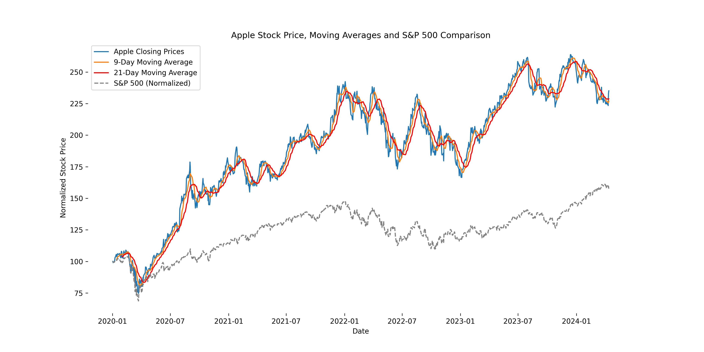
APPLE

Slide 45
LOSS CHART REAL DATA

Slide 46
COMPARISON TO BASELINE MODEL
SYNTHETIC DATA
REAL DATA

Slide 47
RESEARCH INSIGHT
Hashtag #TESLA or User ID: Elon Musk

Slide 48
FUTURE IMPLICATION / CURRENT LIMITATION
FINANCE
INCLUDE MORE STOCK FEATURE
Include data such as open, close, high low and real-time data from Bloomberg
Include more overall stock market data such as inflation, interest rates, gold prices, housing prices
HEDGING (RISK MODELLING)
Use the model to prevent rare stock price volatility events and hedge against them
OPTIONS PRICES and STRATEGIES
Option contract prices are future looking so include current market sentiment about the future

Slide 49
FUTURE IMPLICATION / CURRENT LIMITATION
MODELLING - COMPUTER SCIENCE
MODEL FINE TUNING
Models can be fine tuned through model analysis
MODEL COMPARISON STUDIES
Compare the model performance across multiple models
K FOLD CROSS VALIDATION
Validate the model across different timeseries to understand its use and function

Slide 50
THANK YOU!
Efsa AKTAY

